Slide 2
Unit -1 Operating System Overview
Unit 1-
Operating System Overview: Operating system objectives and functions, evolution of operating system, basic concepts: Processes, Files, System Calls, Layered structure v/s Monolithic structure of OS

Slide 3
Operating System
A program that controls the execution of application programs
A program that controls the execution of users programs
An interface between applications and hardware

Slide 4
1. Operating System Objectives
Convenience
Makes the computer more convenient to use
Efficiency
Allows computer system resources to be used in an efficient manner
Ability to evolve
Permit effective development, testing, and introduction of new system functions without interfering with service

Slide 5
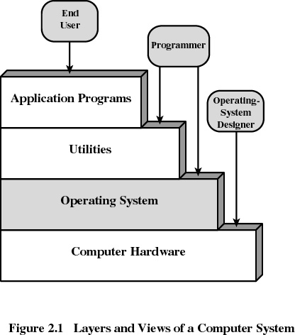
2. Layers of Computer System

Slide 6
Kernel
Heart (vital portion) of the operating system
Next to Hardware
It always resides in main memory
Contains most-frequently used functions
Also called the nucleus

Slide 7
3. Services Provided by the Operating System
Program development
Editors, compilers, linker, loader and debuggers
Program execution
Access to I/O devices
Controlled access to files
Access to other plug and play devices
Security to users programs and applications

Slide 8
Services Provided by the Operating System
Error detection and response
internal and external hardware errors
memory error
device failure
software errors
arithmetic overflow
access forbidden memory locations

Slide 9
Services Provided by the Operating System
Accounting
collect statistics
monitor performance

Slide 10
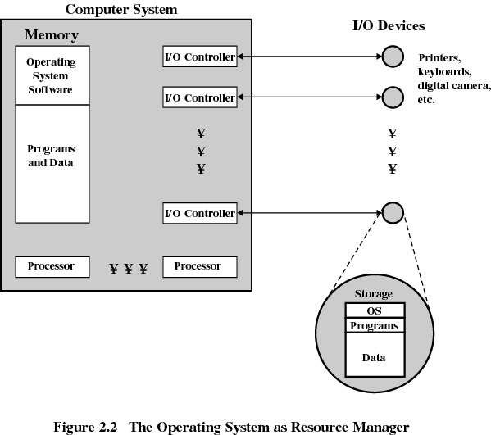

Slide 11
4. Evolution of Operating Systems
4.1 Serial Processing
No operating system
Machines run from a console with display lights and toggle switches, input device, and printer
Setup included loading the compiler, source program, saving compiled program, and loading and linking

Slide 12
Evolution of Operating Systems
4.2 Simple Batch Systems
Monitors
Software that controls the running programs
Batch jobs together
Program branches back to monitor when finished
Resident monitor is in main memory and available for execution

Slide 13
Job Control Language (JCL)
Special type of programming language
Provides instruction to the monitor
what compiler to use
what data to use

Slide 14
Hardware Features
Memory protection
do not allow the memory area containing the monitor to be altered
Timer
prevents a job from monopolizing the system

Slide 15

4.3 Uniprogramming
Processor must wait for I/O instruction to complete before preceding

Slide 16
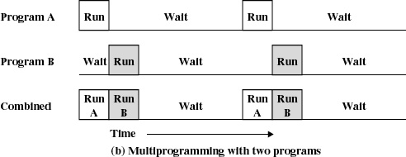
4.4 Multiprogramming
When one job needs to wait for I/O, the processor can switch to the other job

Slide 17
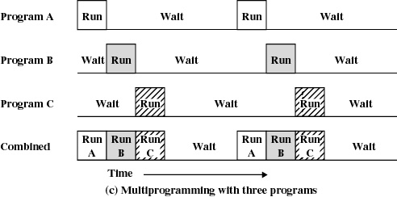
Multiprogramming

Slide 18
Example
JOB1 JOB2 JOB3
Type of job Heavy compute Heavy I/O Heavy I/O
Duration 5 min. 15 min. 10 min.
Memory required 50K 100 K 80 K
Need disk? No No Yes
Need terminal No Yes No
Need printer? No No Yes

Slide 19
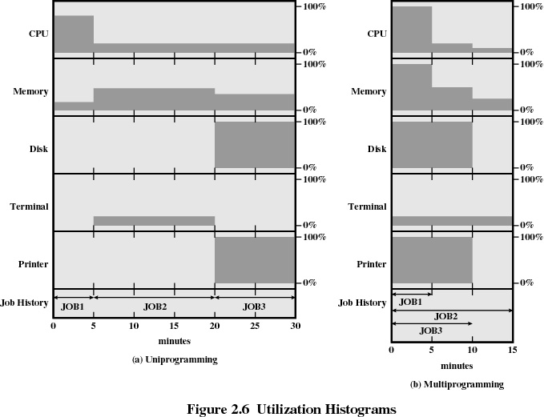

Slide 20
Effects of Multiprogramming
Uniprogramming Multiprogramming
Processor use 22% 43%
Memory use 30% 67%
Disk use 33% 67%
Printer use 33% 67%
Elapsed time 30 min. 15 min.
Throughput rate 6 jobs/hr 12 jobs/hr

Slide 21
4.5 Time Sharing
Using multiprogramming to handle multiple interactive jobs
Processor’s time is shared among multiple users
Multiple users simultaneously access the system through terminals

Slide 22
Batch Multiprogramming versus Time Sharing
 | Batch Multiprogramming | Time Sharing
Principal objective | Maximize processor use | Minimize response time
Source of directives to operating system | Job control language commands provided with the job | Commands entered at the terminal

Slide 23
Major Achievements
Running processes simultaneously
Memory Management
Information protection and security
Scheduling and resource management

Slide 24
5. Processes
A program in execution
An instance of a program running on a computer
The entity that can be assigned to and executed on a processor
A unit of activity characterized by a single sequential thread of execution, a current state, and an associated set of system resources

Slide 25
Process
Consists of three components
An executable program
Associated data needed by the program
Execution context of the program
All information the operating system needs to manage the process

Slide 26
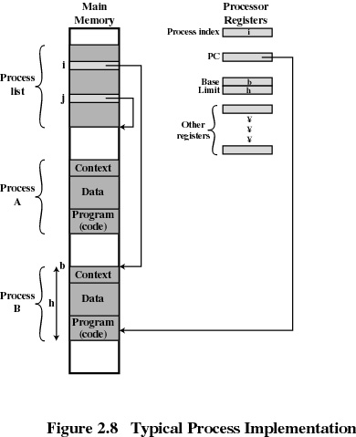
Process

Slide 27
6. Memory Management
Process isolation
Automatic allocation and management
Support for modular programming
Protection and access control
Long-term storage

Slide 28
Virtual Memory
Allows programmers to address memory from a logical point of view
While one process is written out to secondary store and the successor process read in there in no interruption

Slide 29
File System
Implements long-term store
Information stored in named objects called files

Slide 30
Information Protection and Security
Access control
regulate user access to the system
Information flow control
regulate flow of data within the system and its delivery to users
Certification
proving that access and flow control perform according to specifications

Slide 31
7. Scheduling and Resource Management
Fairness
give equal and fair access to all processes
Differential responsiveness
discriminate between different classes of jobs
Efficiency
maximize throughput, minimize response time, and accommodate as many uses as possible

Slide 32
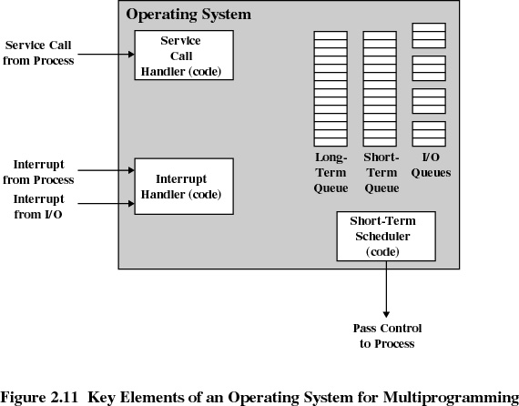
Major Elements of Operating System

Slide 33
System Structure
View the system as a series of levels
Each level performs a related subset of functions
Each level relies on the next lower level to perform more primitive functions
This decomposes a problem into a number of more manageable subproblems

Slide 34
5. Characteristics of Modern Operating Systems
Microkernel architecture
assigns only a few essential functions to the kernel
address space
Inter-process communication (IPC)
basic scheduling

Slide 35
Characteristics of Modern Operating Systems
Multithreading
Process is divided into threads that can run simultaneously
Thread
Dispatch-able unit of work
Executes sequentially and is interruptible
Process is a collection of one or more threads

Slide 36
Characteristics of Modern Operating Systems
Symmetric multiprocessing
There are multiple processors
These processors share same main memory and I/O facilities
All processors can perform the same functions

Slide 37
Characteristics of Modern Operating Systems
Distributed operating systems
Provides the illusion of a single main memory and single secondary memory space
Used for distributed file system

Slide 38
Characteristics of Modern Operating Systems
Object-oriented design
Used for adding modular extensions to a small kernel
Enables programmers to customize an operating system without disrupting system integrity

Slide 39
8. Operating System Design Hierarchy
Level name Objects Example Operations
13. Shell User programming Statements in shell language environment
. User processes User processes Quit, kill, suspend, resume
11 . Directories Directories Create, destroy, attach, search, list
10. Devices External devices, such Open, close,
as printer, displays read, write
and keyboards
9. File system Files Create, destroy, open, close, read, write
8.Communications Pipes Create, destroy, open. close, read, write

Slide 40
Operating System Design Hierarchy
Level name Objects Example Operations
7.Virtual Memory Segments, pages Read, write, fetch
6. Local secondary Blocks of data, device Read, write, allocate, free store channels
5. Primitive processes primitive process, Suspend, resume, wait, signal,semaphores, ready list

Slide 41
Operating System Design Hierarchy
Level name Objects Example Operations
4 Interrupts Interrupt-handling Invoke, mask, unmask, Programs retry
Procedures Procedure, call stack, Mark stack, call, return
Instruction Set Evaluation stack, micro- Load, store, add, subtract program interpreter,
branch scalar and array data
Electronic Registers, gates, buses, Clear, transfer,
circuit activate, etc.

Slide 42
Unit 2
Process
and
Process Scheduling

Slide 43
1. Major Requirements of an Operating System
Interleave the execution of several processes to maximize processor utilization while providing reasonable response time
Allocate resources to processes
Support inter-process communication and
Creation of user processes

Slide 44
2. Process
Also called a task
Execution of an individual program
Can be traced
list the sequence of instructions that execute

Slide 45
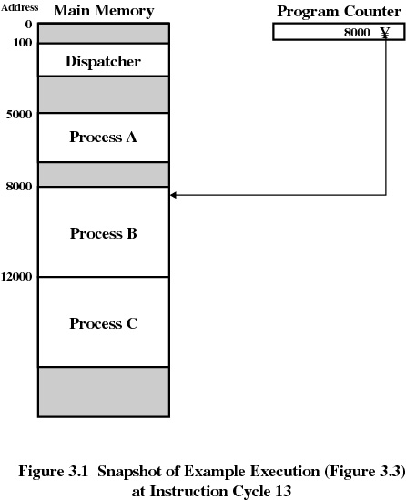

Slide 46
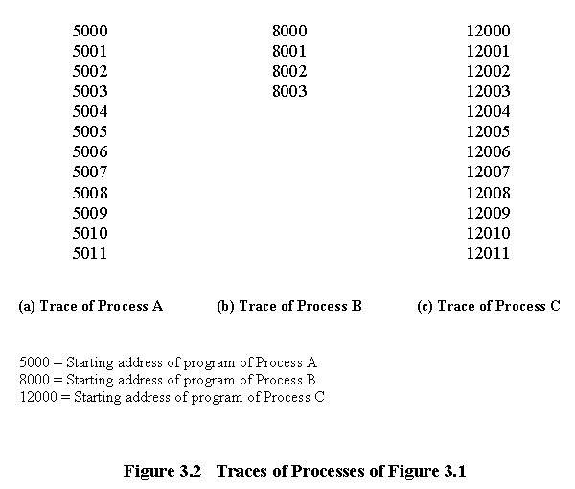

Slide 47
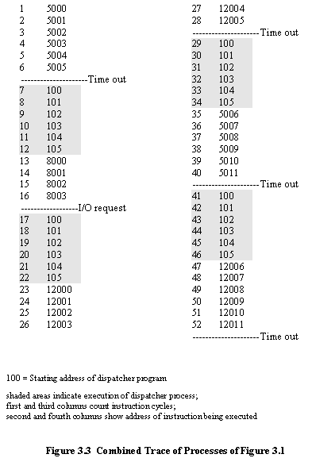

Slide 48
3. Process Creation (how?)
Submission of a batch job
User logs on
Created to provide a service such as printing
Process creates another process
Batch job issues Halt instruction
User logs off
Quit an application
Error and fault conditions

Slide 49
Reasons for Process Termination
Normal completion
Time limit exceeded
Memory unavailable
Bounds violation
Protection error
example write to read-only file
Arithmetic error
Time overrun
process waited longer than a specified maximum for an event

Slide 50
Reasons for Process Termination
I/O failure
Invalid instruction
happens when try to execute data
Privileged instruction
Data misuse
Operating system intervention
such as when deadlock occurs
Parent terminates so child processes terminate
Parent request

Slide 51
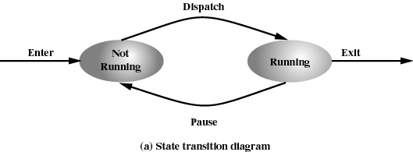
4. Two-State Process Model
Process may be in one of two states
Running
Not-running

Slide 52
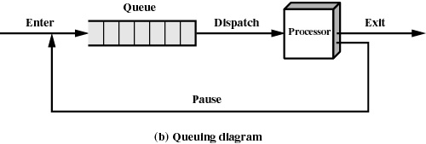
Not-Running Process in a Queue

Slide 53
Processes
Not-running
ready to execute
Blocked
waiting for I/O
Dispatcher cannot just select the process that has been in the queue the longest because it may be blocked

Slide 54
5. A Five-State Model
Running
Ready
Blocked
New
Exit

Slide 55
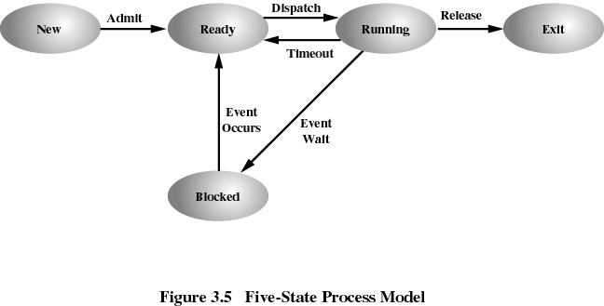

Slide 56
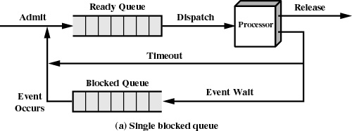
Using Two Queues

Slide 57
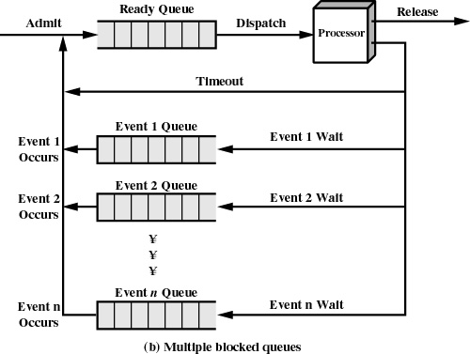

Slide 58
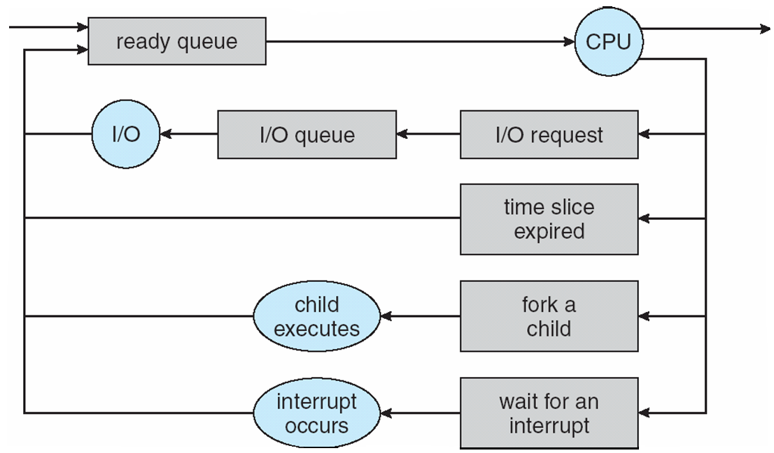
Example

Slide 59
6. Suspended Processes
Processor is faster than I/O so all processes could be waiting for I/O
Swap these processes to disk to free up more memory
Blocked state becomes suspend state when swapped to disk
Two new states
Blocked, suspend
Ready, suspend

Slide 60
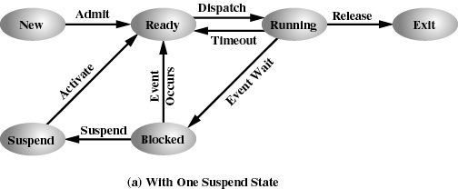
One Suspend State

Slide 61
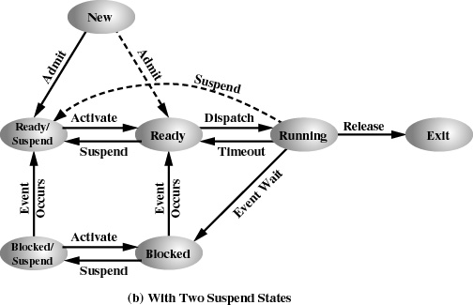
Two Suspend States

Slide 62
7. Operating System Control Structures
Information about the current status of each process and resource
Tables are constructed for each entity the operating system manages

Slide 63
7.a Memory Tables
Allocation of main memory to processes
Allocation of secondary memory to processes
Protection attributes for access to shared memory regions
Information needed to manage virtual memory

Slide 64
7.b I/O Tables
I/O device is available or assigned
Status of I/O operation
Location in main memory being used as the source or destination of the I/O transfer

Slide 65
7.c File Tables
Existence of files
Location on secondary memory
Current Status
Attributes
Sometimes this information is maintained by a file-management system

Slide 66
7.d Process Table
Where process is located
Attributes necessary for its management
Process ID
Process state
Location in memory

Slide 67
Process Location
Process includes set of programs to be executed
Data locations for local and global variables
Any defined constants
Stack
Process control block
Collection of attributes
Process image
Collection of program, data, stack, and attributes

Slide 68
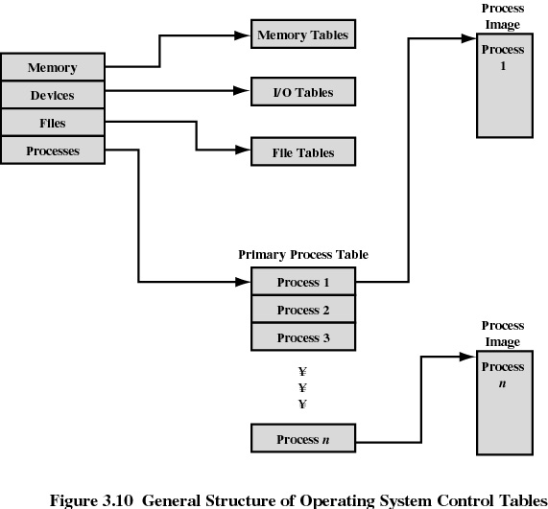

Slide 69
8. Process Control Block
1. Process identification
(Identifiers)
Numeric identifiers that may be stored with the process control block include
Identifier of this process
Identifier of the process that created this process (parent process)
User identifier

Slide 70
Process Control Block
2. Processor State Information
2.1 User-Visible Registers
A user-visible register is one that may be referenced by means of the machine language that the processor executes.
Typically, there are from 8 to 32 of these registers, although some RISC implementations have over 100.

Slide 71
Process Control Block
Processor State Information (contd..)
2.2 Control and Status Registers
These are a variety of processor registers that are employed to control the operation of the processor. These include
• Program counter: Contains the address of the next instruction to be fetched
• Condition codes: Result of the most recent arithmetic or logical operation (e.g., sign, zero, carry, equal, overflow)
• Status information: Includes interrupt enabled/disabled flags, execution mode

Slide 72
Process Control Block
Processor State Information (contd…..)
Stack Pointers
Each process has one or more last-in-first-out (LIFO) system stacks associated with it.
A stack is used to store parameters and calling addresses for procedure and system calls.
The stack pointer points to the top of the stack.

Slide 73
Process Control Block
3. Process Control Information
3.1 Scheduling and State Information
This is information that is needed by the operating system to perform its scheduling function.
Typical items of information:
• Process state: defines the readiness of the process to be scheduled for execution (e.g., running, ready, blocked, halted, exit).
• Priority: One or more fields may be used to describe the scheduling priority of the process.

Slide 74
Process Control Block
Scheduling and State Information (contd…)
Scheduling-related information: This will depend on the scheduling algorithm used.
Examples:- the amount of time that the process has been waiting and
the amount of time that the process executed the last time it was running.
Event: Identity of event the process is awaiting before it can be resumed

Slide 75
Process Control Block
Process Control Information (contd…)
Data Structuring
A process may be linked to other process in a queue, ring, or some other structure.
For example, all processes in a waiting state for a particular priority level may be linked in a queue.
A process may exhibit a parent-child (creator-created) relationship with another process.
The process control block may contain pointers to other processes to support these structures.

Slide 76
Process Control Block
Process Control Information (contd…..)
Inter-process Communication
Various flags, signals, and messages may be associated with communication between two independent processes.
Some or all of this information may be maintained in the process control block.
Process Privileges
Processes are granted privileges in terms of the memory that may be accessed and the types of instructions that may be executed.
In addition, privileges may apply to the use of system utilities and services.

Slide 77
Process Control Block
Process Control Information (contd….)
Memory Management
This section may include pointers to segment and/or page tables that describe the virtual memory assigned to this process.
Resource Ownership and Utilization
Resources controlled by the process may be indicated, such as opened files.
A history of utilization of the processor or other resources may also be included; this information may be needed by the scheduler.

Slide 78
